Slide 1
Predicting Molecular Mutagenicity
kNN for SPR Modeling
Aditya Raj
National Institute of Technology, Patna

Slide 2
kNN for SPR Modeling
Predicting Molecular Mutagenicity
This document is for the model structure and preprocessing for kNN based solution to predict molecular mutagenicity.

Slide 3
Preprocessing
The preprocessing steps are designed to transform the raw dataset into a clean, normalized, and feature-optimized format suitable for kNN modeling. Each step is applied sequentially, ensuring that the data is properly prepared for accurate predictions.
['Unnamed: 0', 'Id', 'SMILES’]
These columns were dropped.
Some rows in the column, [‘Predicted’]have [‘Non Predicted’], which was removed.
'NumValenceElectrons', 'qed’
were removed as they show –ve correlation to the predicted element.
1. Drop Useless Columns
2. Check Missing/Error rows and remove
3. Correlation Matrix
Class distribution was checked, for the model to be free of bias and not bend towards a particular class.
The elements were scaled using StandardScaler(),as kNN is distance based.
Model Fitting and Training
4. Class Distribution was checked
5. StandardScaler()
6. Fitting

Slide 4
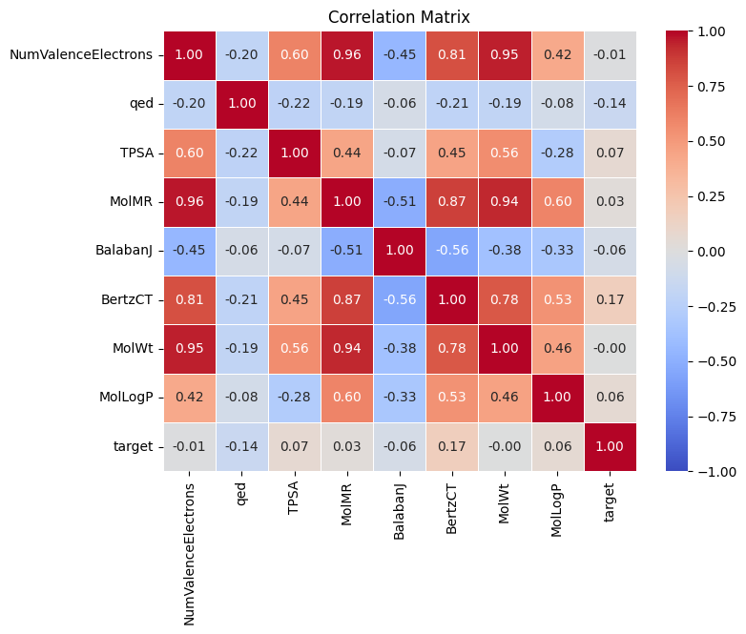
Correlation Matrix
The plot of Correlation Matrix
NumValenceElectroncs and qed has –ve correlation to target hence, removing them is a wise choice.

Slide 5
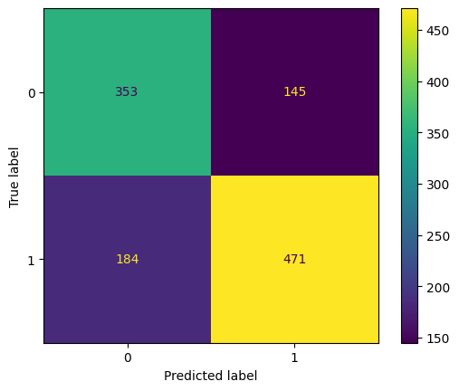
Confusion Matrix
Accuracy: 71.96574154379879 % Precision: 0.7646103896103896 Recall: 0.7190839694656489
F1: 0.7576942228095987

Slide 6
Cross Validation
10-fold cross validation was done to access the model’s performance and make it robust.
Cross-Validation Accuracy Scores
[0.69047619, 0.70932755, 0.72017354, 0.68546638, 0.67895879,
0.67245119, 0.70932755, 0.71149675, 0.72451193, 0.70065076]
Mean Cross-Validation Score:
The mean cross-validation accuracy score is: 0.7003
This indicates that the model achieves an average accuracy of approximately 70.03% across all cross-validation folds.

Slide 7
Conclusion
The model achieved an accuracy of 70.04% on 10-fold cross validation and a F1 score of 0.75
There are various other ways to make this model better,
Using advanced scaling methods
Detecting and removing small outliers

Slide 8
Thank You!
adityar.ug22.ec@nitp.ac.in

